Slide 1
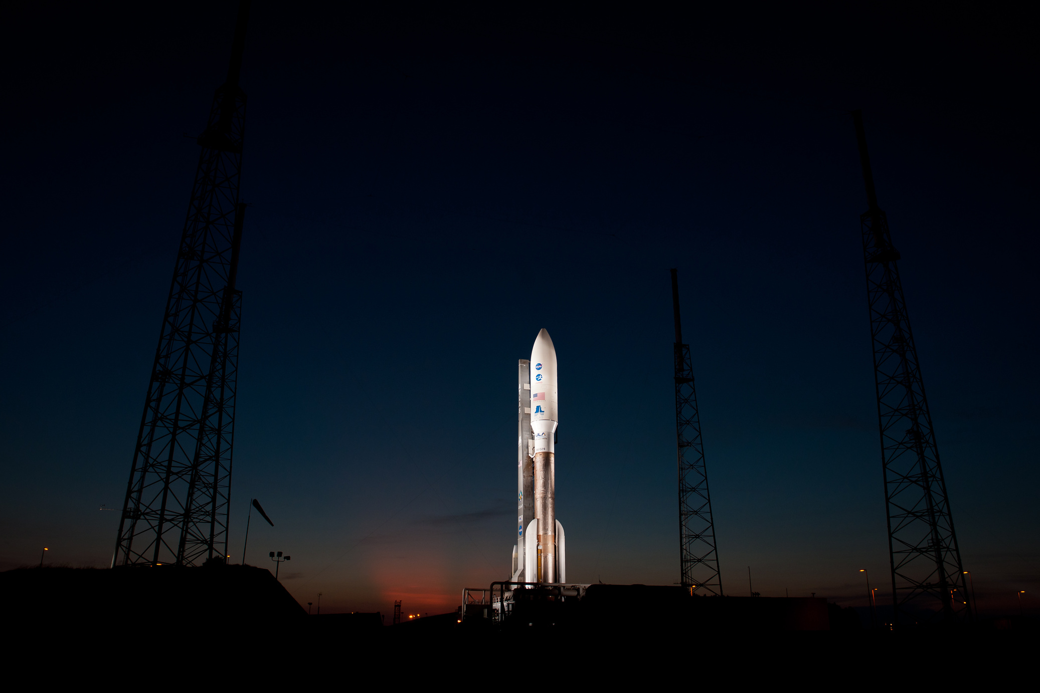

WINNING SPACE RACE WITH DATA SCIENCE

Slide 2

OUTLINE
• •
Executive Summary Introduction
• Methodology
• •
•
Results Conclusion
Appendix
2

Slide 3
EXECUTIVE SUMMARY
The research attempts to identify the factors for a successful rocket landing. To make this determination, the following methodologies where used: • Collect data using SpaceX REST API and web scraping techniques • Wrangle data to create success/fail outcome variable • Explore data with data visualization techniques, considering the following factors: payload, launch site, flight number and yearly trend • Analyze the data with SQL, calculating the following statistics: total payload, payload range for successful launches, and total # of successful and failed outcomes • Explore launch site success rates and proximity to geographical markers • Visualize the launch sites with the most success and successful payload ranges • Build Models to predict landing outcomes using logistic regression, support vector machine (SVM), decision tree
and K -nearest neighbor (KNN
Exploratory Data Analysis:
• Launch success has improved over time •
KSC LC-39A has the highest success rate
among landing sites • Orbits ES -L1, GEO,
HEO, and SSO have a 100% success rate
Visualization/Analytics: • Most launch sites are near the equator, and all are close to the coast Predictive Analytics: • All models performed similarly on the test set. The decision tree
3

Slide 4
INTRODUCTION
•
SpaceX aims to reduce the cost of space travel by recovering the first stage of its rockets. When successful, this recovery can result in savings of up to $100 million per launch. However, these savings are only realized if the first stage is successfully recovered.
Using historical launch data, we seek to predict the likelihood
of first stage recovery by analyzing several key factors:
•
• •
•
•
What impact does payload size have on recovery
success?
How does the launch site influence the outcome?
How has the probability of recovery changed over time?
Does the type of booster affect the chances of a
successful recovery?
4

Slide 5

Section 1
5

Slide 6
METHODOLOGY
Executive Summary •Data collection methodology:
• Using SpaceX’s publicly API (https://api.spacexdata.com/) • Utilizing launch history by scraping data from Falcon 9 Launch Wikipedia pages
•Perform datawrangling
•
Transformed data is easier to analyze and fill in missing data
•Perform exploratory data analysis (EDA) using visualization andSQL
• •
Perform interactive visual analytics using Folium andPlotlyDash Perform predictive analysis using classification models
•
Tuning model data for prediction and validation training
6

Slide 7
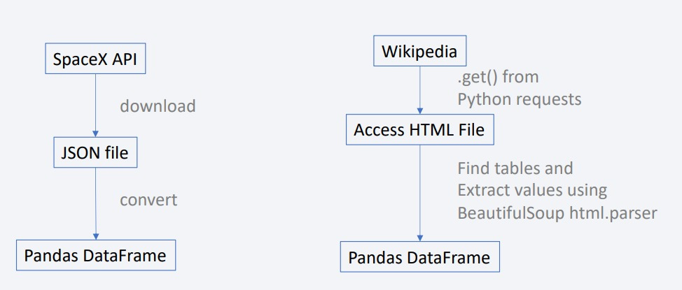
DATA COLLECTION
•Utilizing publicly available data sources (Space X API and webscraping Falcon 9
Launch Wikipedia
7

Slide 8
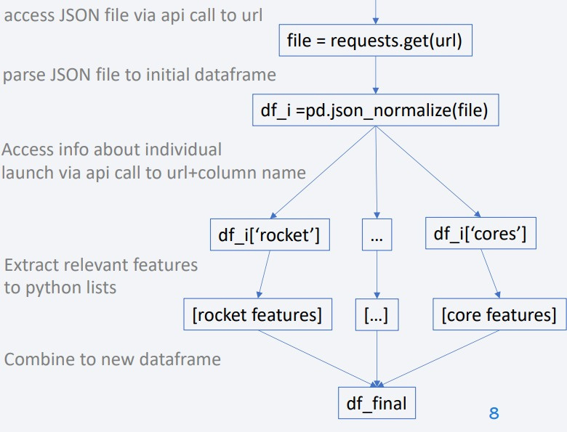

DATA COLLECTION – SPACEX API
•Data collection via SpaceX API
•
Using Pandas dataframe to pull data, accessing main level API where JSON files contain entries to be deciphered
using specific API Calls
Place your flowchart of SpaceX API calls here
•
https://github.com/shinobida/Cour sera-Final/blob/main/jupyter-labs- spacex-data-collection-api.ipynb
8

Slide 9
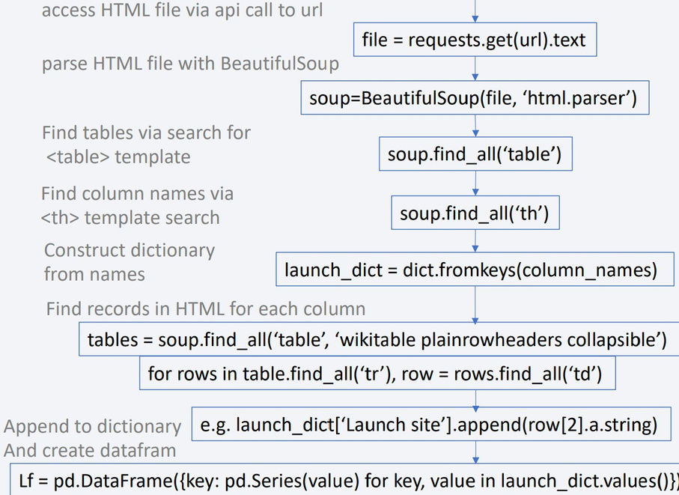
DATA COLLECTION - SCRAPING
•Parsing HTML data from
Falcon 9 Launch Wikipedia
•
https://github.com/shinobida /Coursera- Final/blob/main/jupyter-labs-
webscraping.ipynb
9

Slide 10
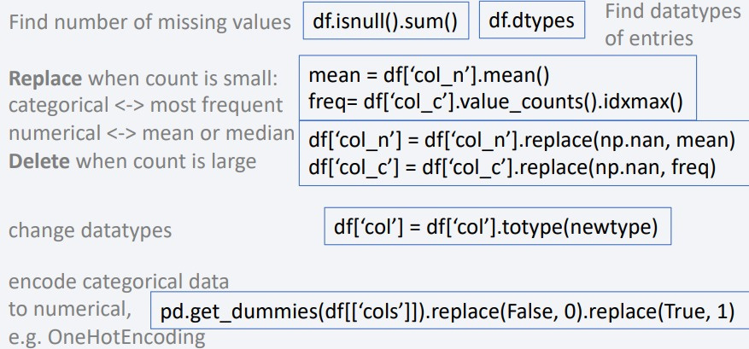
DATA WRANGLING
•
Cleaning datasets to replace/rescale categorical data with numerical values and change types in Data Wrangling
•
Missing values: 28% of LandingPad(categorical) missing. Choose to delete
Landing outcome is categorical is targeted, setting False and
True to 0 and 1, respectively
•
•
https://github.com/shinobida/Courser a-Final/blob/main/labs-jupyter- spacex-Data%20wrangling.ipynb
10

Slide 11
EDA WITH DATA VISUALIZATION
•
Utilizing various plats to get a better visualization of data structure
• Scatterplots (all colored by launch outcome)
• Flight Number vs. Payload Mass This helps us see that more recent flights carried up to 8x more weight than early flights and had more successful outcomes • Flight Number vs. Launch Site. We see that Vandenberg is rarely used compared to Kennedy Space Center. Early flights from CCAFS SLC 40 were less successful than later flights. • Payload Mass vs. Launch Site: most low weight and high weight flights leave from KSC, while intermediate weight flights leave from VAFB • Flight Number vs. Orbit: we see that early flights went to LEO, ISS, PO, GFO while later flights went to HEO, VLEO, SO, GEO. Furthermore, LEO success seems to increase with flight number. • Payload vs. Orbit: heavy payloads tend to have more success with PO, LEO, and ISS though for GTO, the data is less clear
• Barplots
• Orbit vs. outcome: we plot the percent of successful flights based on orbit type. ES-L1, GEO, HEO, SSO all have success rates of 1, while GTO has the lowest success rate of 0.5
• Lineplots
• Success vs. year: we see the success rate tend to increase over the years, with a dip in 2018 and no change from 2010-2013 and from 2014-2015
•
https://github.com/shinobida/Coursera-Final/blob/main/edadataviz.ipynb
11

Slide 12
EDA WITH SQL
• • •
List unique launch sites:: %sql select DISTINCT "Launch_Site" from SPACEXTABLE Display 5 records where launch sites begin with string ‘CCA’: %sql select * from SPACEXTABLE where "Launch_Site" like 'CCA%' limit 5 Display total payload mass carried by boosters launched by NASA (CRS) : %sql select sum(PAYLOAD_MASS__KG_) from SPACEXTABLE where Customer
like 'NASA (CRS)%’
Display average payload mass carried by booster version F9 v1.1: %sql select avg(PAYLOAD_MASS__KG_) from SPACEXTABLE where "Booster_Version"
like 'F9 v1.1%’
List the date when the first successful landing outcome in ground pad was achieved: %sql select min(Date) from SPACEXTABLE where
•
•
"Landing_Outcome" like 'Success (ground pad)’ List the names of the booster w/ success in drone ship and mass between 4000 and 6000: %sql select distinct "Booster_Version" from SPACEXTABLE
where (("Landing_Outcome" like 'Success (drone ship)') and (4000<=PAYLOAD_MASS__KG_<=6000))
Display total success and failure: %sql select "Mission_Outcome", count("Mission_Outcome") from SPACEXTABLE group by "Mission_Outcome"
List all the booster versions that have carried the maximum payload: %sql select distinct "Booster_Version" from SPACEXTABLE where
•
• •
PAYLOAD_MASS__KG_ = (select max(PAYLOAD_MASS__KG_) from SPACEXTABLE) List records from the year 2015: %sql select substr(Date, 6, 2) as month, "Landing_Outcome", "Booster_Version", "Launch_Site" from SPACEXTABLE
where (substr(Date, 0, 5)='2015' and "Landing_Outcome" like 'Failure (Drone Ship)’)
Rank the landing outcomes between 2010-06-04 and 2017-03-20 in descending order: %sql select "Landing_Outcome", count(*) as Count from
SPACEXTABLE where (Date > '2010-06-04' and Date < '2017-03-20') Group By "Landing_Outcome" Order By Count DESC
•
•
12
https://github.com/shinobida/Coursera-Final/blob/main/jupyter-labs-eda-sql-coursera_sqllite.ipynb

Slide 13
BUILD AN INTERACTIVE MAP WITH FOLIUM
•Creating an interactive map using Folium. MarkerClusters grouping for markers at
Vandenburg and Kennedy Space Center
•
Color coding launches by success or failure
•
Showing additional landmarks to indicate why launch sites are chosen (isolation from population, railroad access, optimal flight locations
https://github.com/shinobida/Coursera-
Final/blob/main/lab_jupyter_launch_site_location.ipynb
•
13

Slide 14
BUILD A DASHBOARD WITH PLOTLY DASH
•Using Plotly Dash, created a dashboard that
• •
Pie plot showing success rate at specific sites Scatterplot showing success rate vs payload range
• •
Including graphics that would compare individual results to overall results https://github.com/shinobida/Coursera-Final/blob/main/spacex-dash-app.py
14

Slide 15
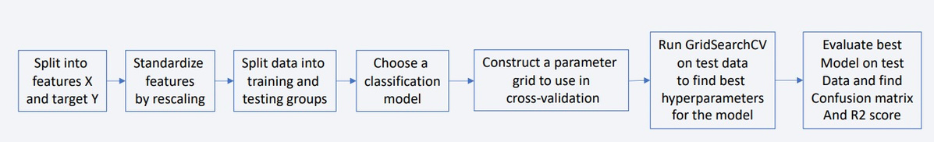
PREDICTIVE ANALYSIS (CLASSIFICATION)
•
Our objective was to predict the success of rocket launches based on a range of influencing factors. To achieve this, we evaluated several classification algorithms, including logistic regression, support vector machines, decision trees, and K-nearest neighbors. We optimized each model's hyperparameters using GridSearchCV with
cross-validation, integrated within streamlined model pipelines. Our workflow followed these key steps:
• https://github.com/shinobida/Coursera-
Final/blob/main/SpaceX_Machine%20Learning%20Prediction_Part_5.ipynb
15

Slide 16
RESULTS
• • •
Exploratory data analysis results Interactive analytics demo in screenshots Predictive analysis results
16

Slide 17

Section 2

Slide 18
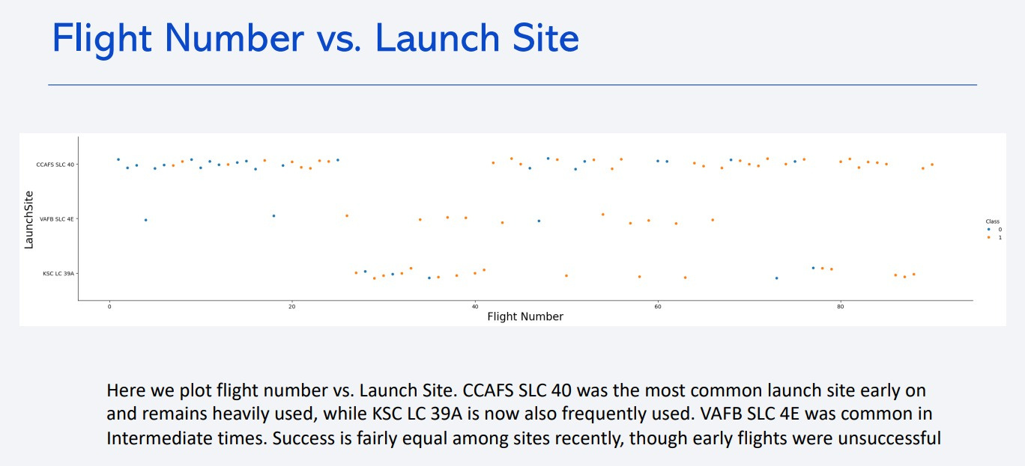
18

Slide 19
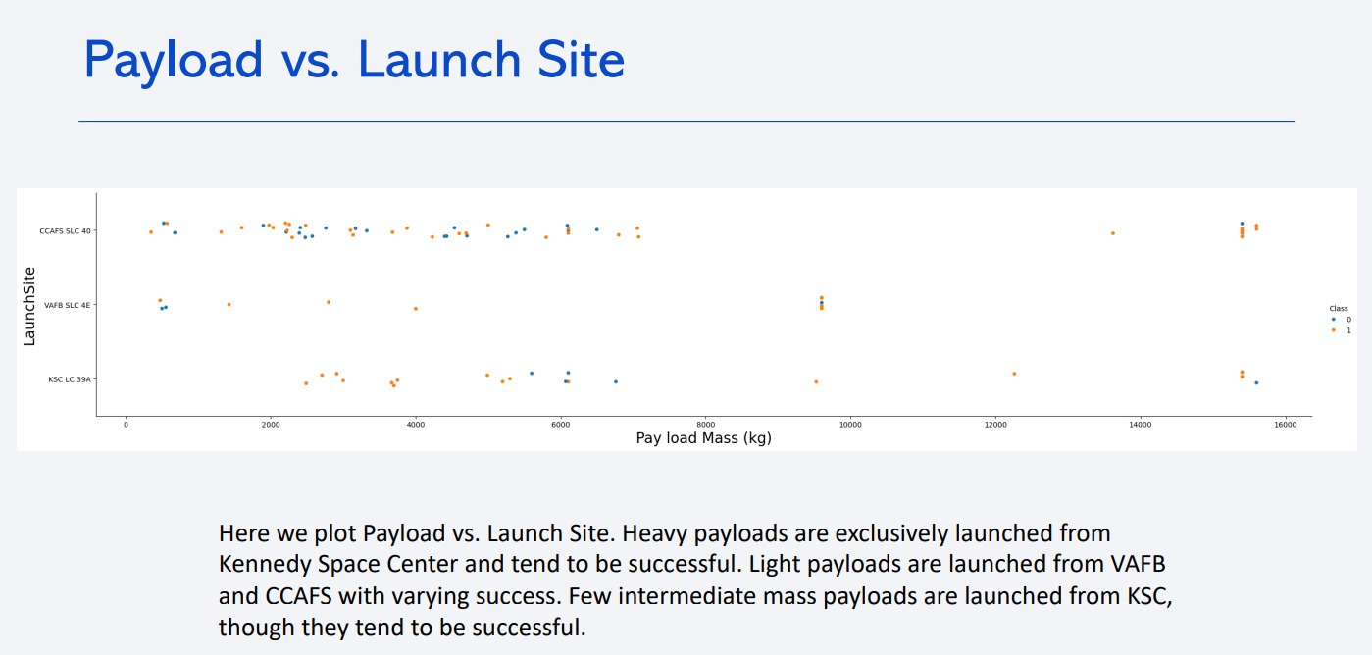
•
Show a scatter plot ofPayload vs. Launch Site
•
Show the screenshot of the scatter plot with explanations
19

Slide 20
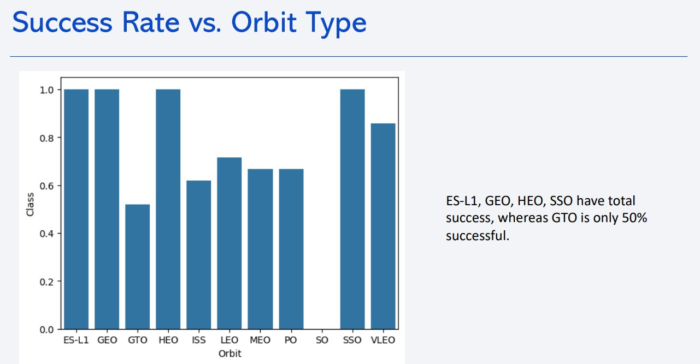
•
Show a bar chart for the success rate of each orbit type
•
Show the screenshot of the scatter plot with explanations
20

Slide 21
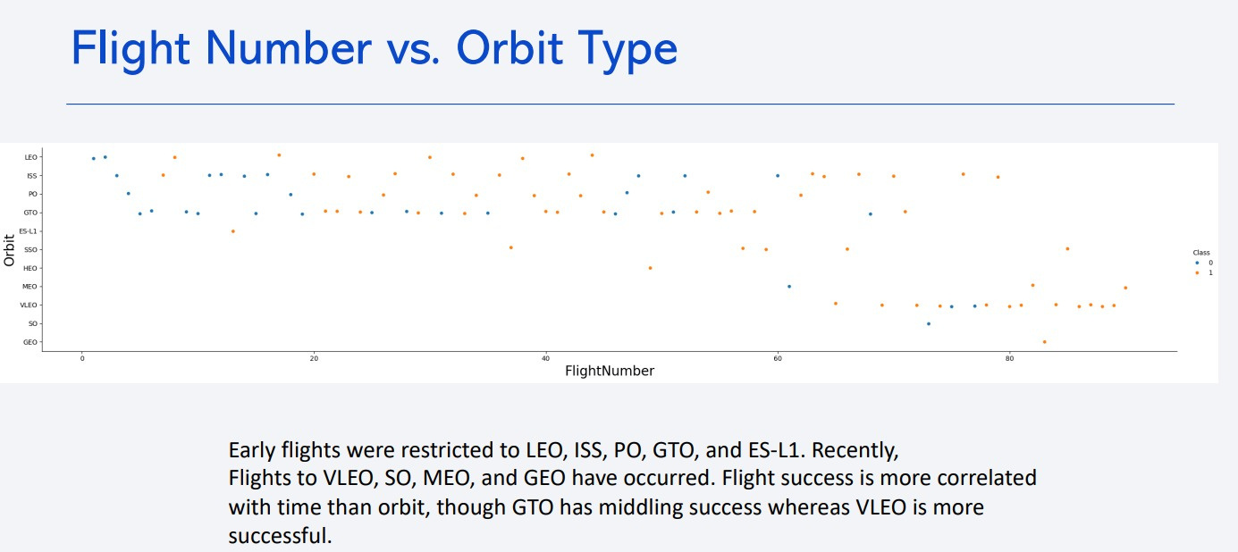
•
Show a scatter point of Flight number vs. Orbit type
•
Show the screenshot of the scatter plot with explanations
21

Slide 22
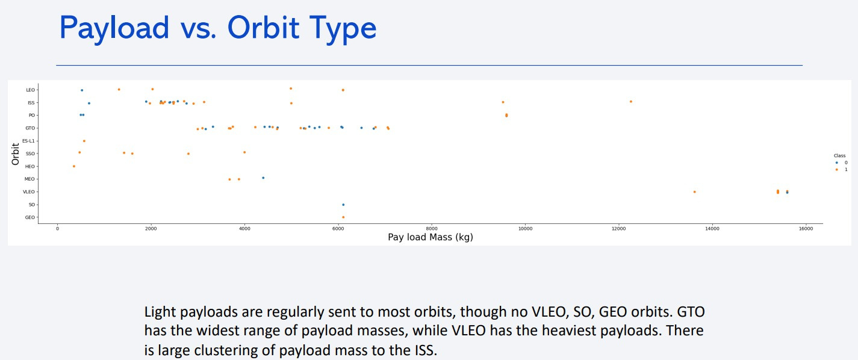
•
Show a scatter point of payload vs. orbit type
•
Show the screenshot of the
scatter plot with explanations
22

Slide 23
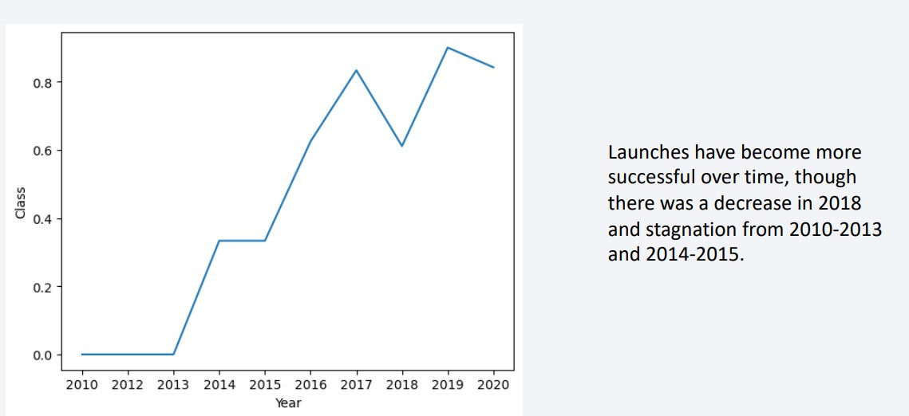
Launch Success Yearly Trend
•
Show a line chart of yearly average success rate
•
Show the screenshot of the scatter plot with explanations
23

Slide 24
All Launch Site Names
•Use SQL query to find unique launch site names
select DISTINCT "Launch_Site" from SPACEXTABLE
•Using “DISTINCT” on the Launch_Site column ensures results are unique to
the field
24

Slide 25
Launch Site Names Begin with 'CCA'
• •
select * from SPACEXTABLE where "Launch_Site" like 'CCA%' limit 5 This will pull 5 records with launch site beginning with CCA
•The * symbol means to choose all columns from the table
25

Slide 26
Total Payload Mass
•
select sum(PAYLOAD_MASS__KG_) from SPACEXTABLE where Customer like 'NASA (CRS)%’
SQL query will calculate total payload carried by boosters from NASA (CRS)
The ”sum()” function sums all values in the column PAYLOAD_MASS_KG_ that have a customer matching NASA (CRS).
•
•
26

Slide 27
Average Payload Mass by F9 v1.1
•
select avg(PAYLOAD_MASS__KG_) from SPACEXTABLE where "Booster_Version" like 'F9 v1.1%’
Calculates average payload mass
“avg()” function calculates the average of the column PAYLOAD_MASS__KG_ for records that have a Booster_Version starting
with F9 v1.1 using % as the identifier
•
•
27

Slide 28
First Successful Ground Landing Date
•
select min(Date) from SPACEXTABLE where "Landing_Outcome" like 'Success (ground pad)’
Finds dates of successful first landing on Ground Pad
The “min()” function can parse dates to find the smallest (earliest) date among the entries where the “Landing_Outcome” matches “Success
(ground pad)”
•
•
28

Slide 29
Successful Drone Ship Landing with Payload between 4000 and 6000
•select distinct "Booster_Version" from SPACEXTABLE where
(("Landing_Outcome" like 'Success (drone ship)') and (4000<=PAYLOAD_MASS__KG_<=6000))
•This lists boosters which have successfully landed on drone ship with
•
payload mass over 4000 but under 6000
“distinct” searches for specific/unique names utilizing “and” to combine
queries
29

Slide 30
Total Number of Successful and FailureMission Outcomes
•
select "Mission_Outcome", count("Mission_Outcome") from SPACEXTABLE group by "Mission_Outcome“
Calculates total number of mission outcomes (successful and failures)
•
•
select count("Mission_Outcome") as "Successful Missions" from SPACEXTABLE where Mission_Outcome like 'Success%’
Splits mission outcomes to exclude failures and group all Successes
•
30

Slide 31
Boosters Carried MaximumPayload
•%sql select BOOSTER_VERSION as boosterversion from SPACEXTBL where
PAYLOAD_MASS__KG_=(select max(PAYLOAD_MASS__KG_) from
SPACEXTBL);
•
Lists names of booster which carried max payload
31

Slide 32
2015 Launch Records
•select substr(Date, 6, 2) as month, "Landing_Outcome" , "Booster_Version"
, "Launch_Site" from SPACEXTABLE where (substr(Date, 0, 5)='2015' and "Landing_Outcome" like 'Failure (Drone Ship)’)
•Lists failed landing_outcomes in droneship, booster version, launch site
names in 2015
•Sqllite syntax requires that we use substr(Date, 6, 2) to look for months and
substr(Date, 0, 5) to look for years.
32

Slide 33
Rank Landing Outcomes Between 2010-06-04 and 2017-03-20
•To rank the count of landing outcomes (such as Failure (drone ship) or
Success (ground pad)) between the date 2010-06-04 and 2017-03-20, in descending order, use the sql query:
•select "Landing_Outcome", count(*) as Count from SPACEXTABLE where
(Date > '2010-06-04' and Date < '2017-03-20') Group By
"Landing_Outcome" Order By Count DESC
•Ranks landing outcome counts between dates 2010-06-04 and 2017-03-20,
in descending order
•We can group records by Landing_Outcome and then calculate the total
counts in each group using count(*), renaming the column ”Count.”, order
the results by the new column “Count” in descending order using “order by
Count desc"
33

Slide 34

Section 3

Slide 35
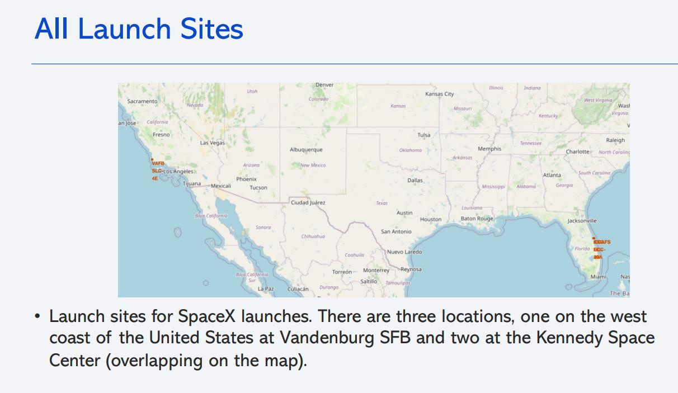
<Folium Map Screenshot 1>
•Replace <Folium map screenshot 1> title with an appropriate title
•
Explore the generated folium map and make a proper screenshot to include all launch sites’ location markers on a global map
•
Explain the important elements and findings on the screenshot
35

Slide 36
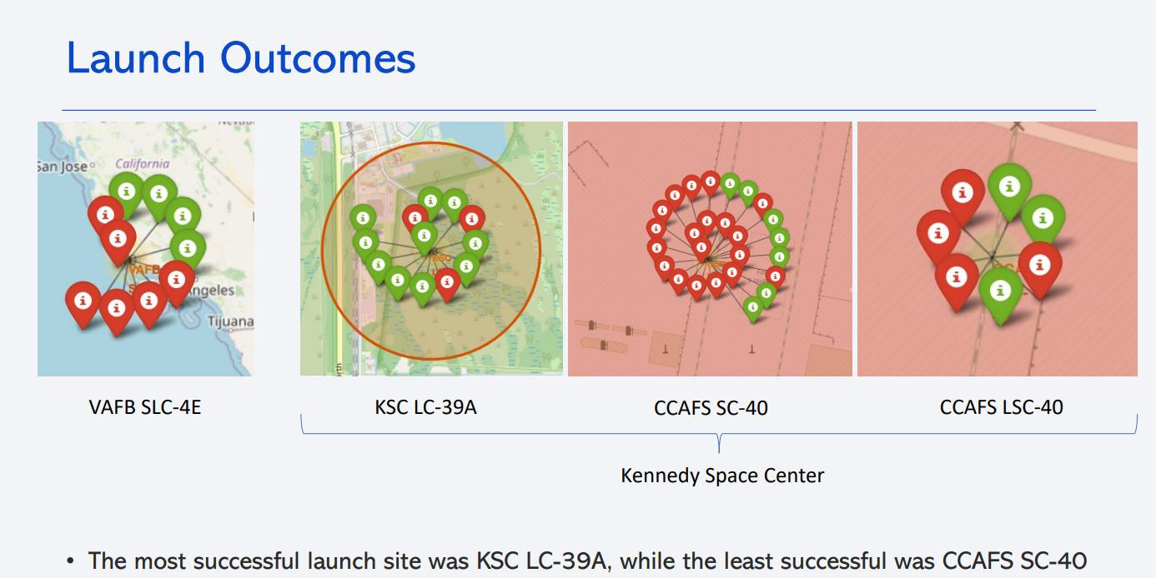
<Folium Map Screenshot 2>
•Replace <Folium map screenshot 2> title with an appropriate title
•
Explore the folium map and make a proper screenshot to show the color- labeled launch outcomes on the map
•
Explain the important elements and findings on the screenshot
36

Slide 37
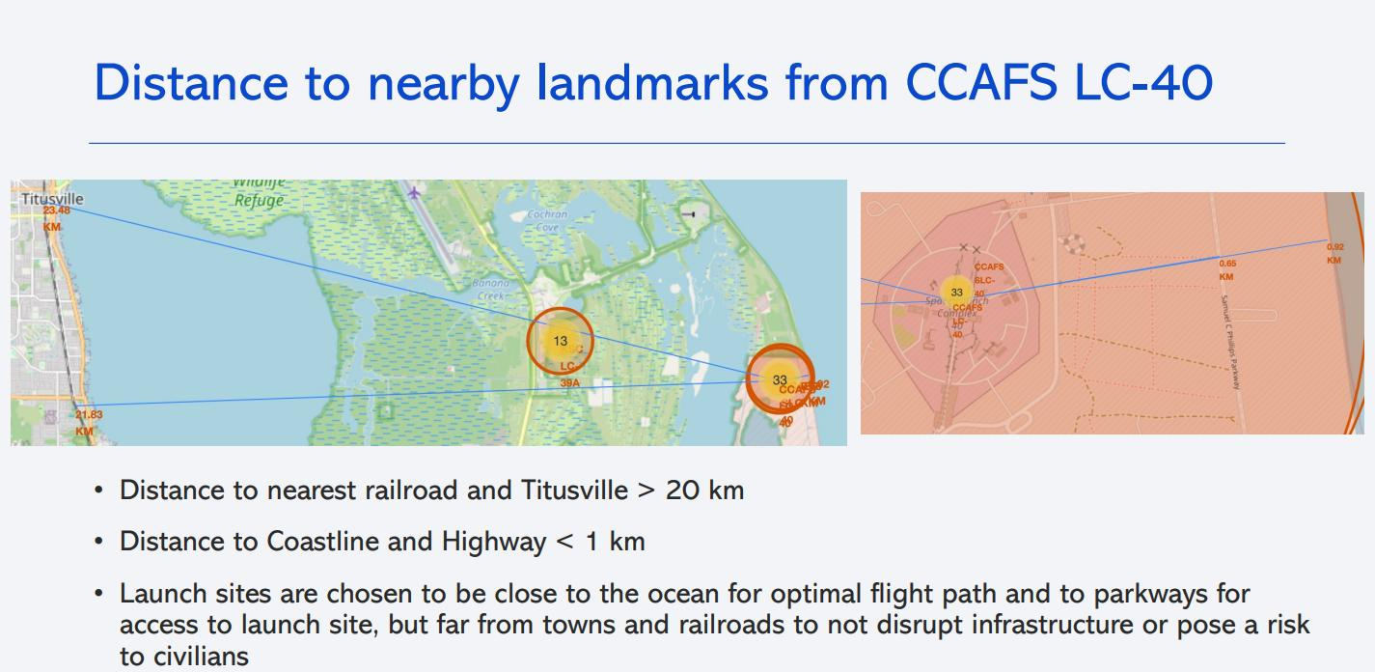
<Folium Map Screenshot 3>
•Replace <Folium map screenshot 3> title with an appropriate title
•
Explore the generated folium map and show the screenshot of a selected launch site to its proximities such as railway, highway, coastline, with distance calculated and displayed
Explain the important elements and findings on the screenshot
•
37

Slide 38

Section 4

Slide 39
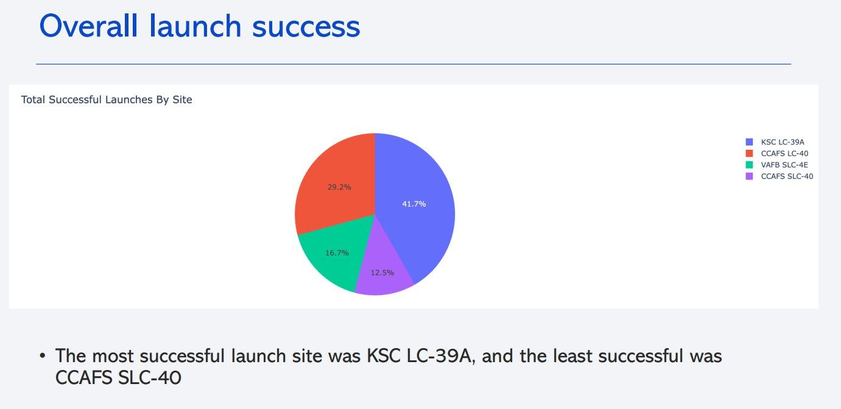
<Dashboard Screenshot 1>
•
Replace <Dashboard screenshot 1> title with an appropriate title
•
Show the screenshot of launch success count for all sites, in a piechart
•
Explain the important elements and findings on the screenshot
39

Slide 40
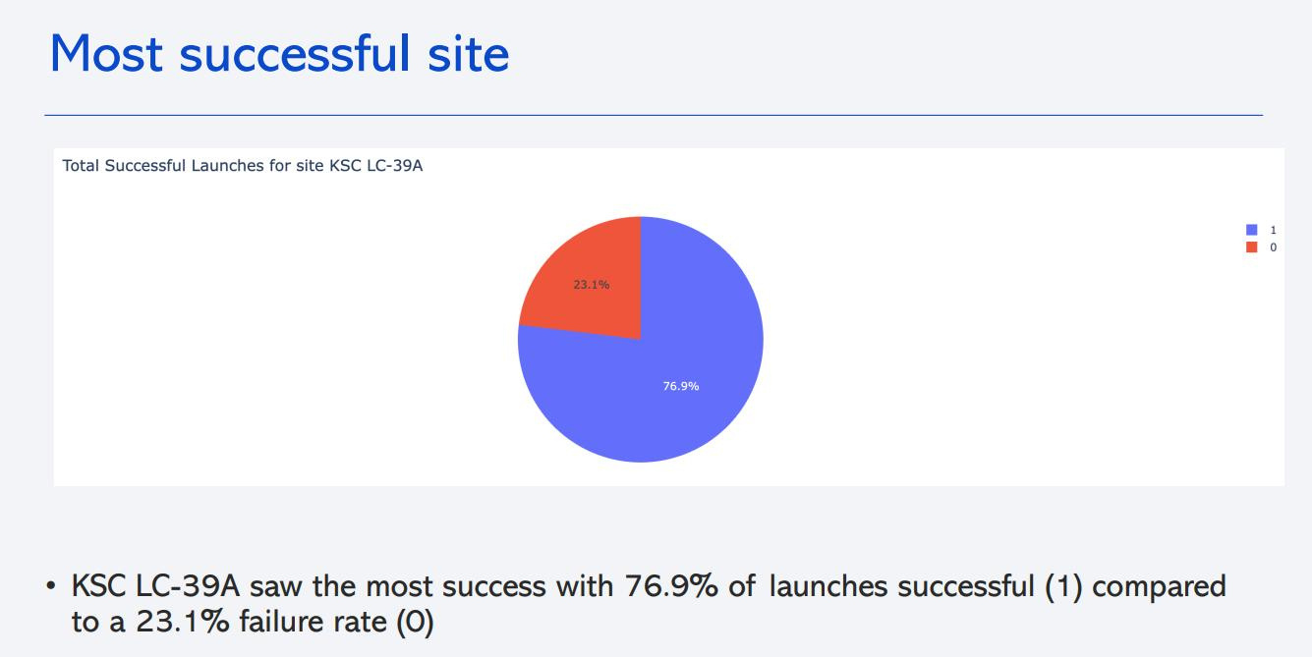
<Dashboard Screenshot 2>
•
Replace <Dashboard screenshot 2> title with an appropriate title
•
Show the screenshot of the piechart for the launch site with highest launch success ratio
•
Explain the important elements and findings on the screenshot
40

Slide 41
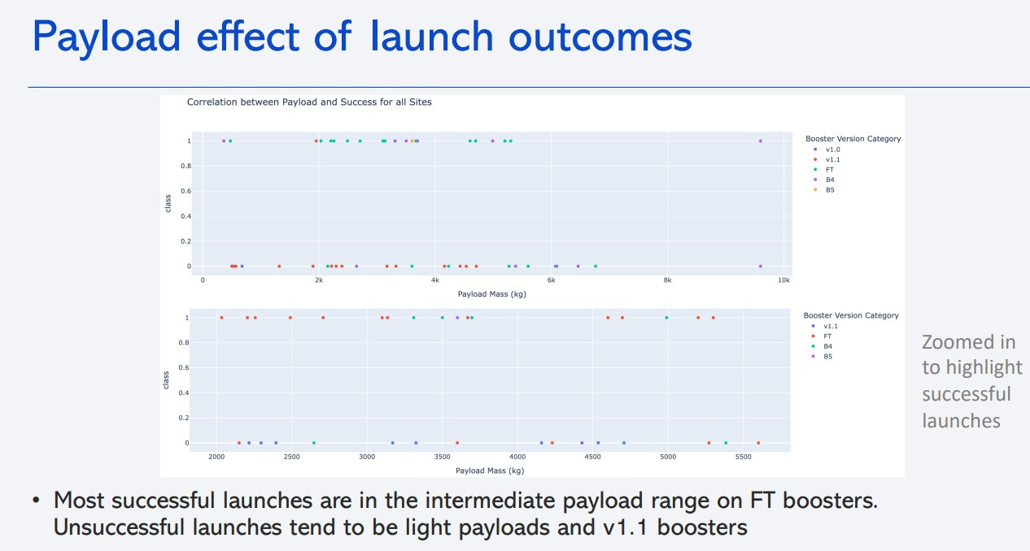
<Dashboard Screenshot 3>
•
Replace <Dashboard screenshot 3> title with an appropriate title
•Show screenshots of Payload vs. Launch Outcome scatter plot for all sites, with
different payload selected in the range slider
•Explain the important elements and findings on the screenshot, such as which
payload range or booster version have the largest success rate, etc.
41

Slide 42

Section 5

Slide 43
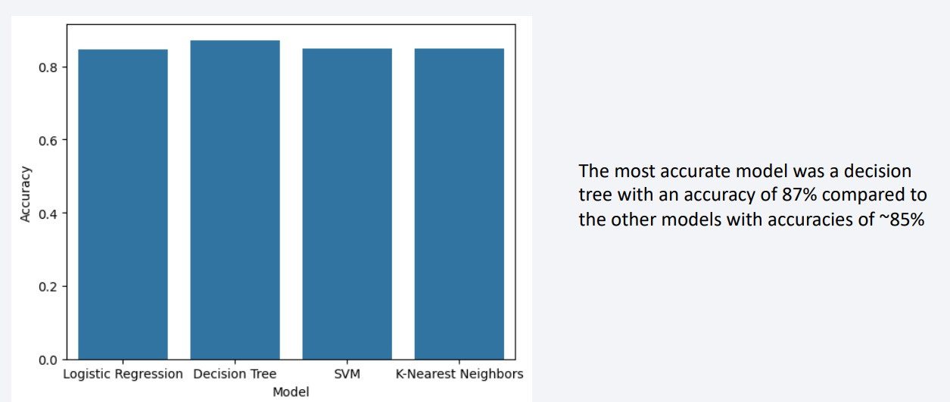
Classification Accuracy
43

Slide 44
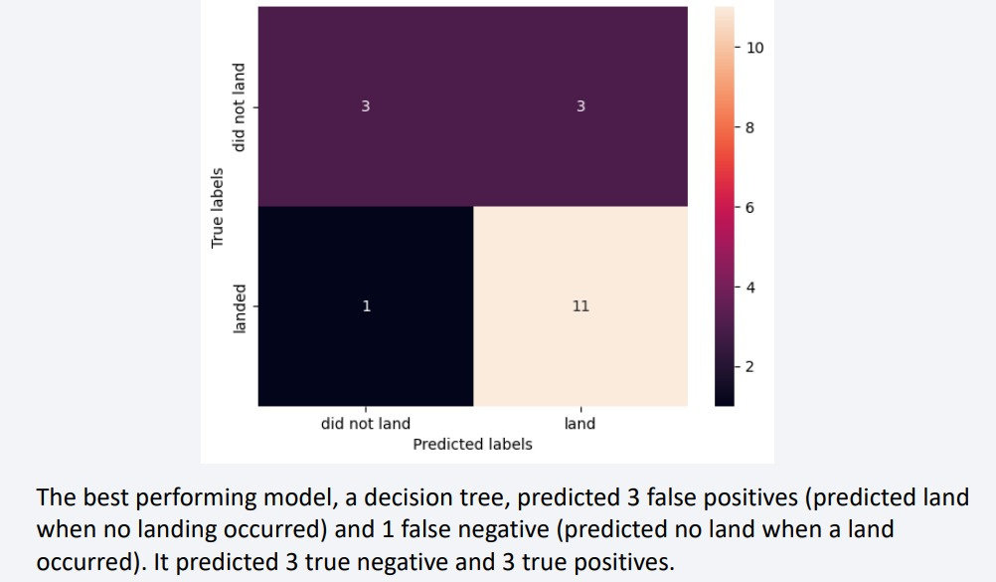
Confusion Matrix
44

Slide 45
Conclusions
•SpaceX launches have shown increasing success rates over time and are now capable of carrying heavier payloads.
•Launch activity at Vandenberg Air Force Base (VAFB) has declined, with Kennedy Space Center emerging as the preferred site for both heavy and light payloads.
•While there is no strong direct correlation between payload weight and launch success, heavier payloads have seen more successful outcomes— likely due to improvements in booster technology and a strong correlation with time.
•Launch success can be effectively predicted using various machine learning models, with the best models achieving an accuracy of approximately 87%.
45

Slide 46
Appendix
•
Include any relevant assets like Python code snippets, SQL queries, charts,
Notebook outputs, or data sets that you may have created during this project
46

Slide 47


